Slide 1

Rehorse
an app for bands
Jos van den Oever

Slide 2
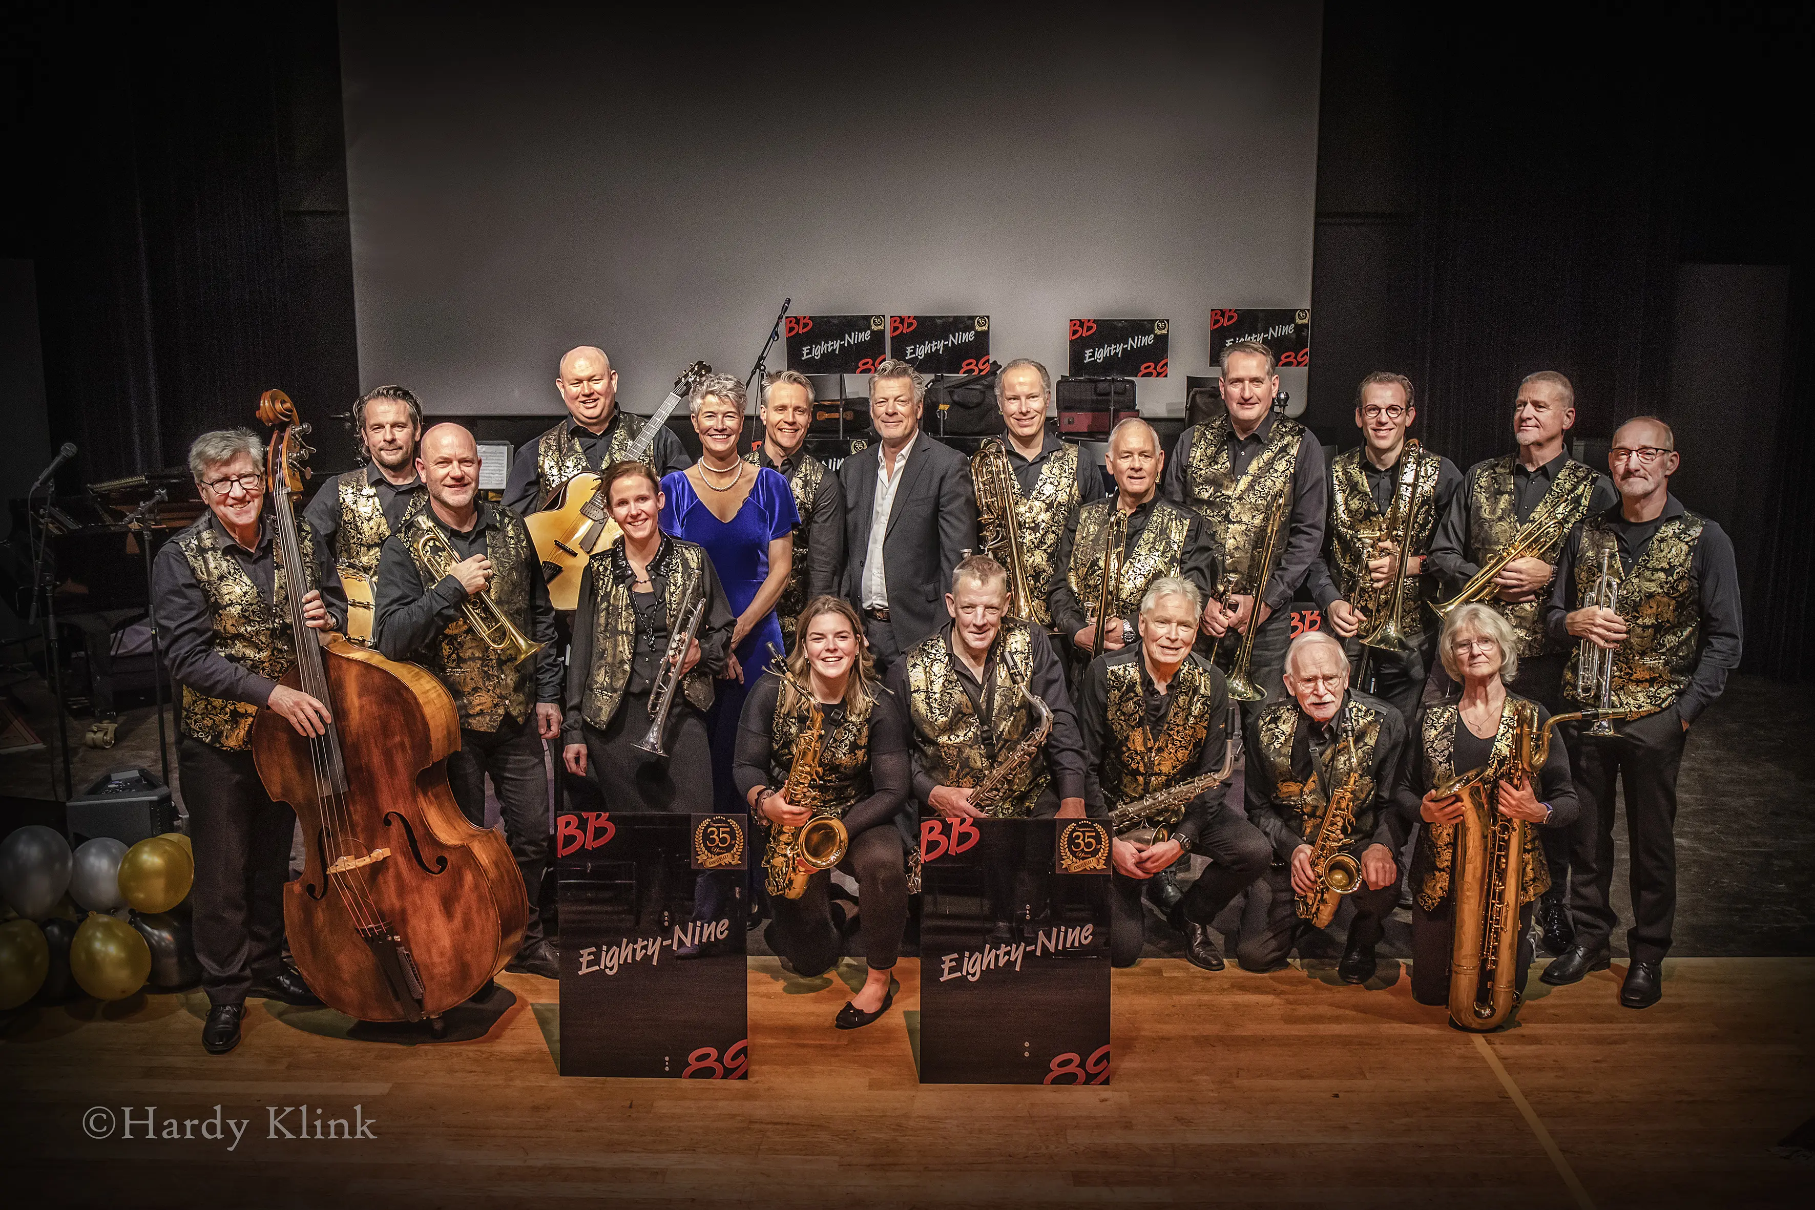

Slide 3
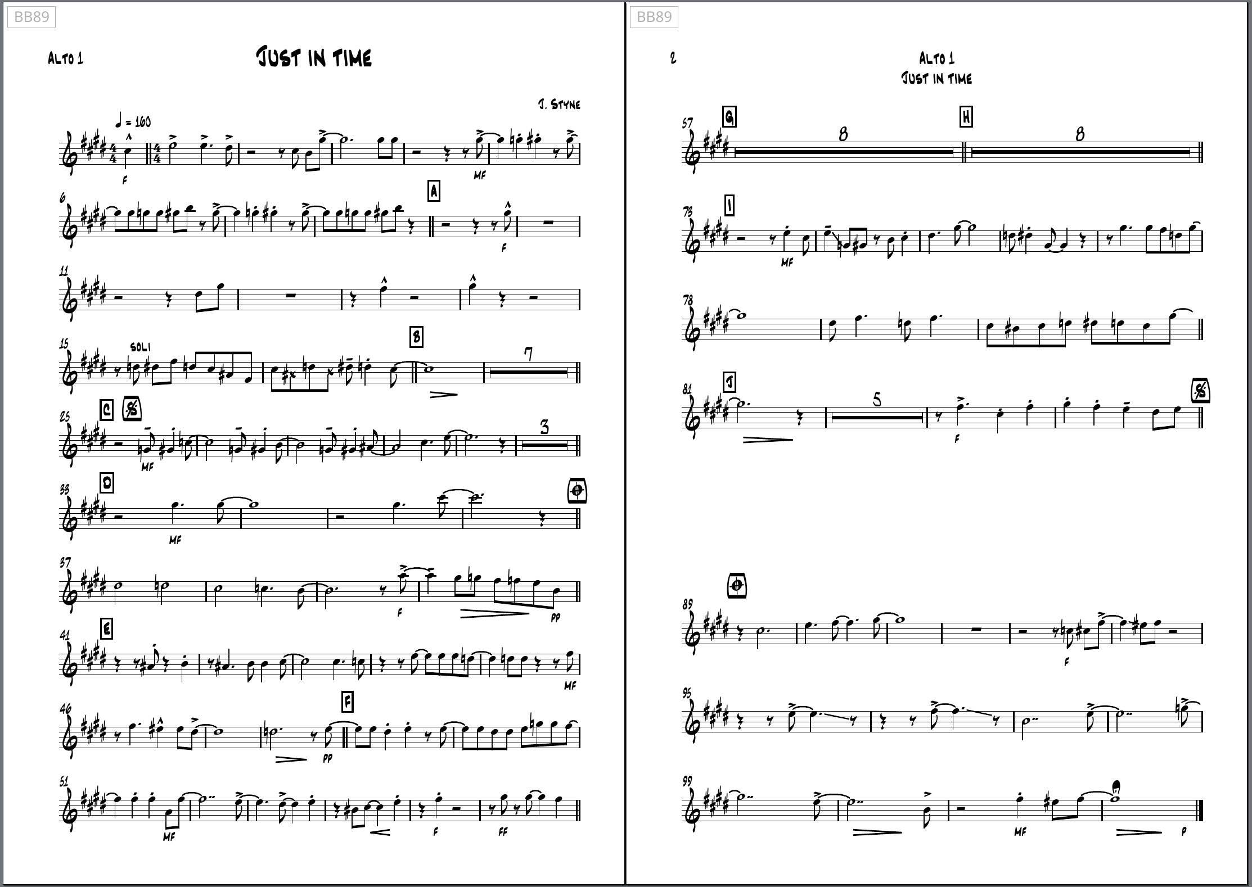

Slide 4
Piano piece

Slide 5
Conductor piece

Slide 6
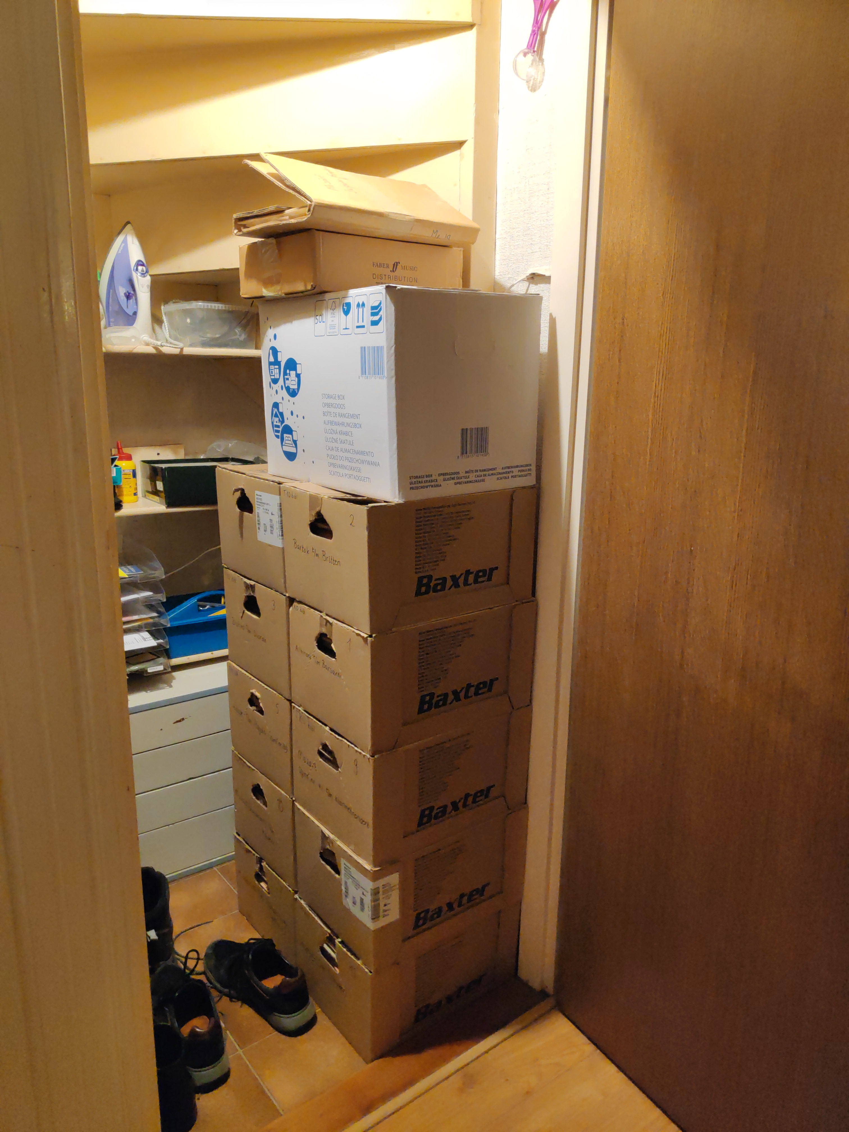
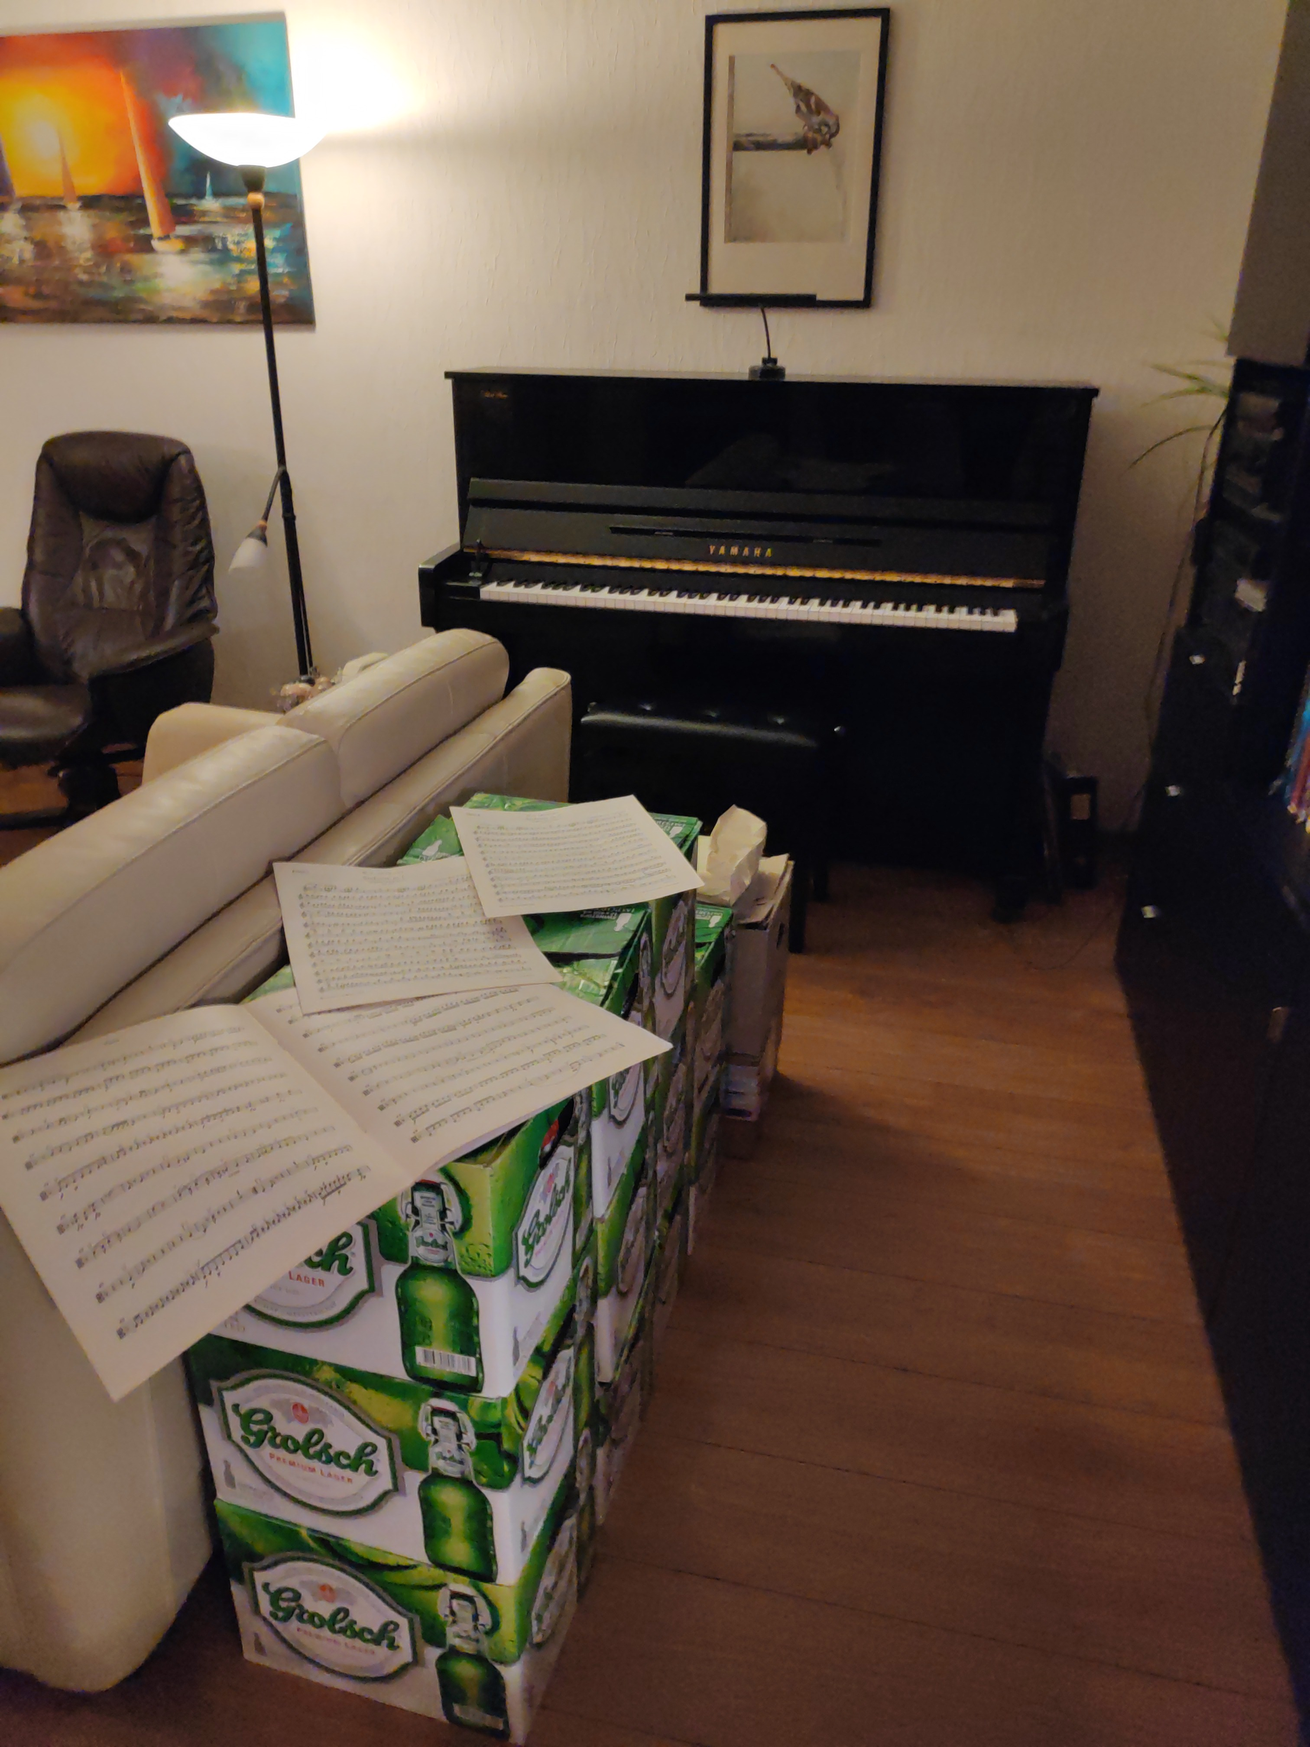

Slide 7
The Paper Era
Large archive with all songs
Heavy binders with sheet music
Musicians only have their own score
Time lost switching between songs
Distributing new songs takes long
Time lost putting songs in order for performances
Coordinate transfer of binder to substitute player
Sheet music become messy from all the annotations and corrections

Slide 8
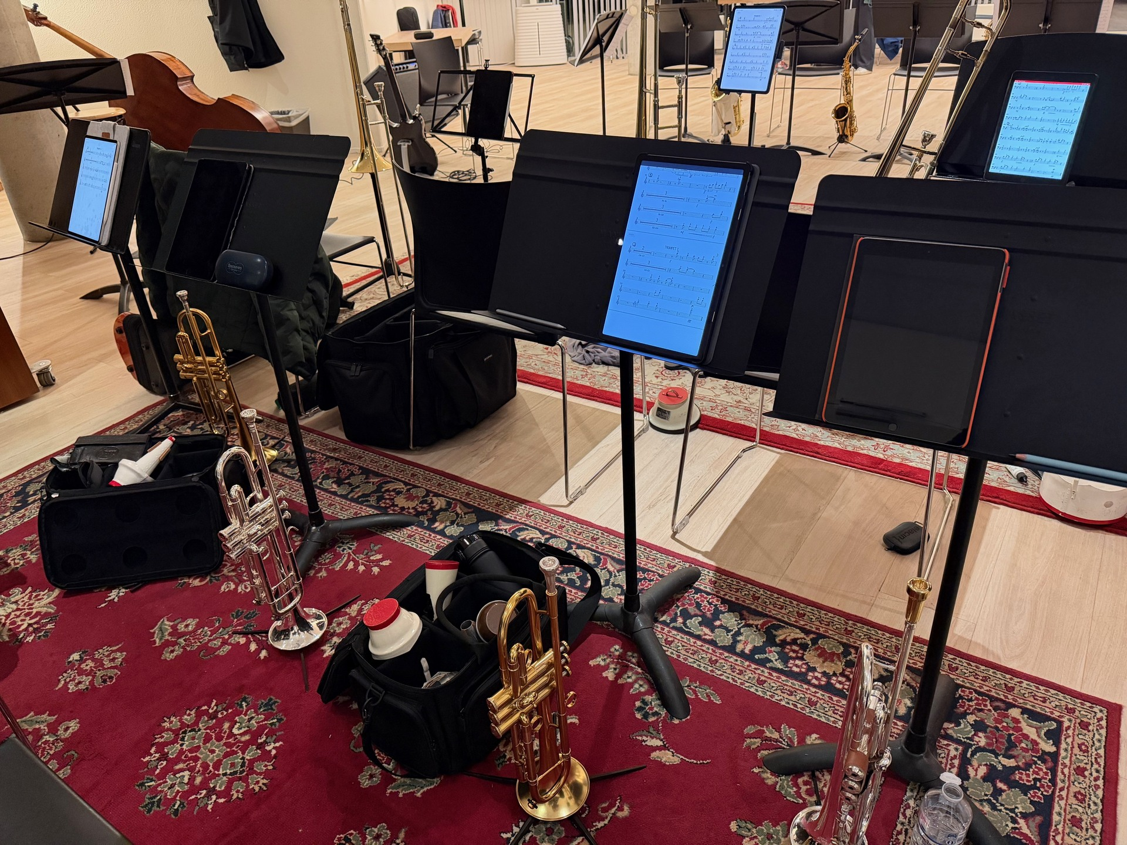

Slide 9
The Digital Era
Individuals buy tablets
Mostly two operating systems (80/20)
Proprietary apps for viewing sheet music
Sheet music on cloud drive
Annotations stored on devices

Slide 10
Dependency on big tech
The most used tablets are closed
Apps need to be approved
App store revenue leads to decent apps initially
Danger of lock-in and enshittification
Feels bad to use

Slide 11
The Third Device
Laptop / Desktop GNU/Linux
Mobile phone /e/OS
Tablet ?

Slide 12
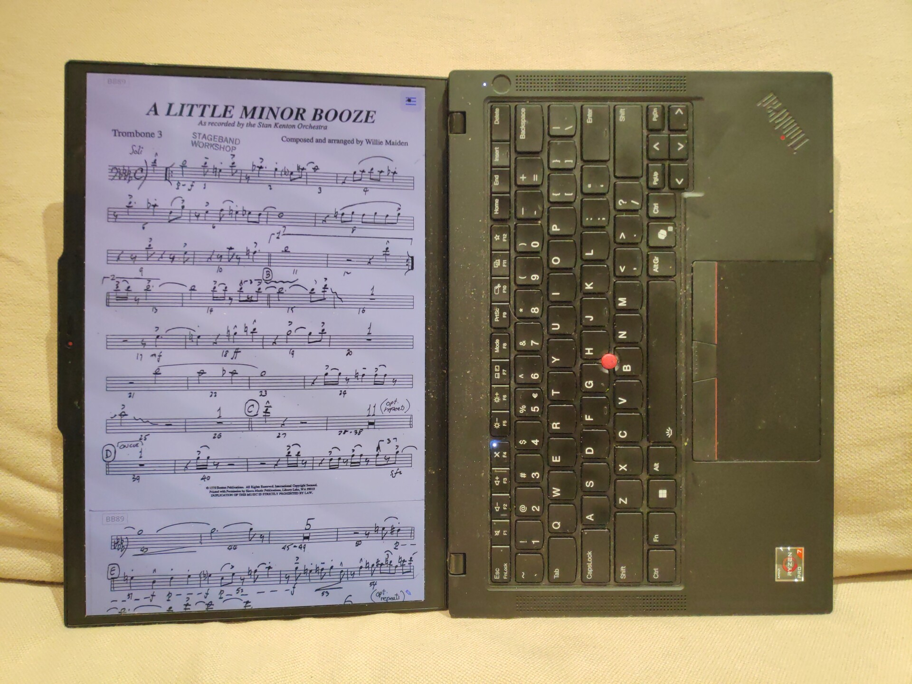

Slide 13
The Third Device
Laptop / Desktop GNU/Linux
Mobile phone /e/OS
Tablet Laptop with touchscreen
2nd hand iPad

Slide 14
A Better DIGItal Era
Self-host Free Software
Independent of operating system
Shared notes and clever library
Let’s write an app!

Slide 15
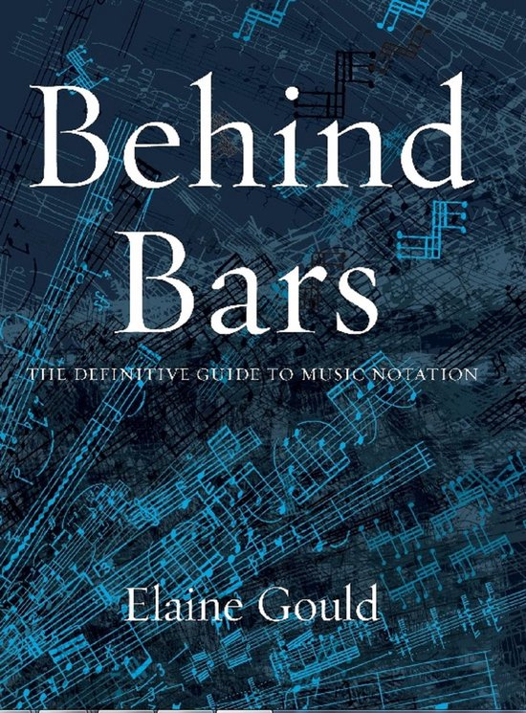
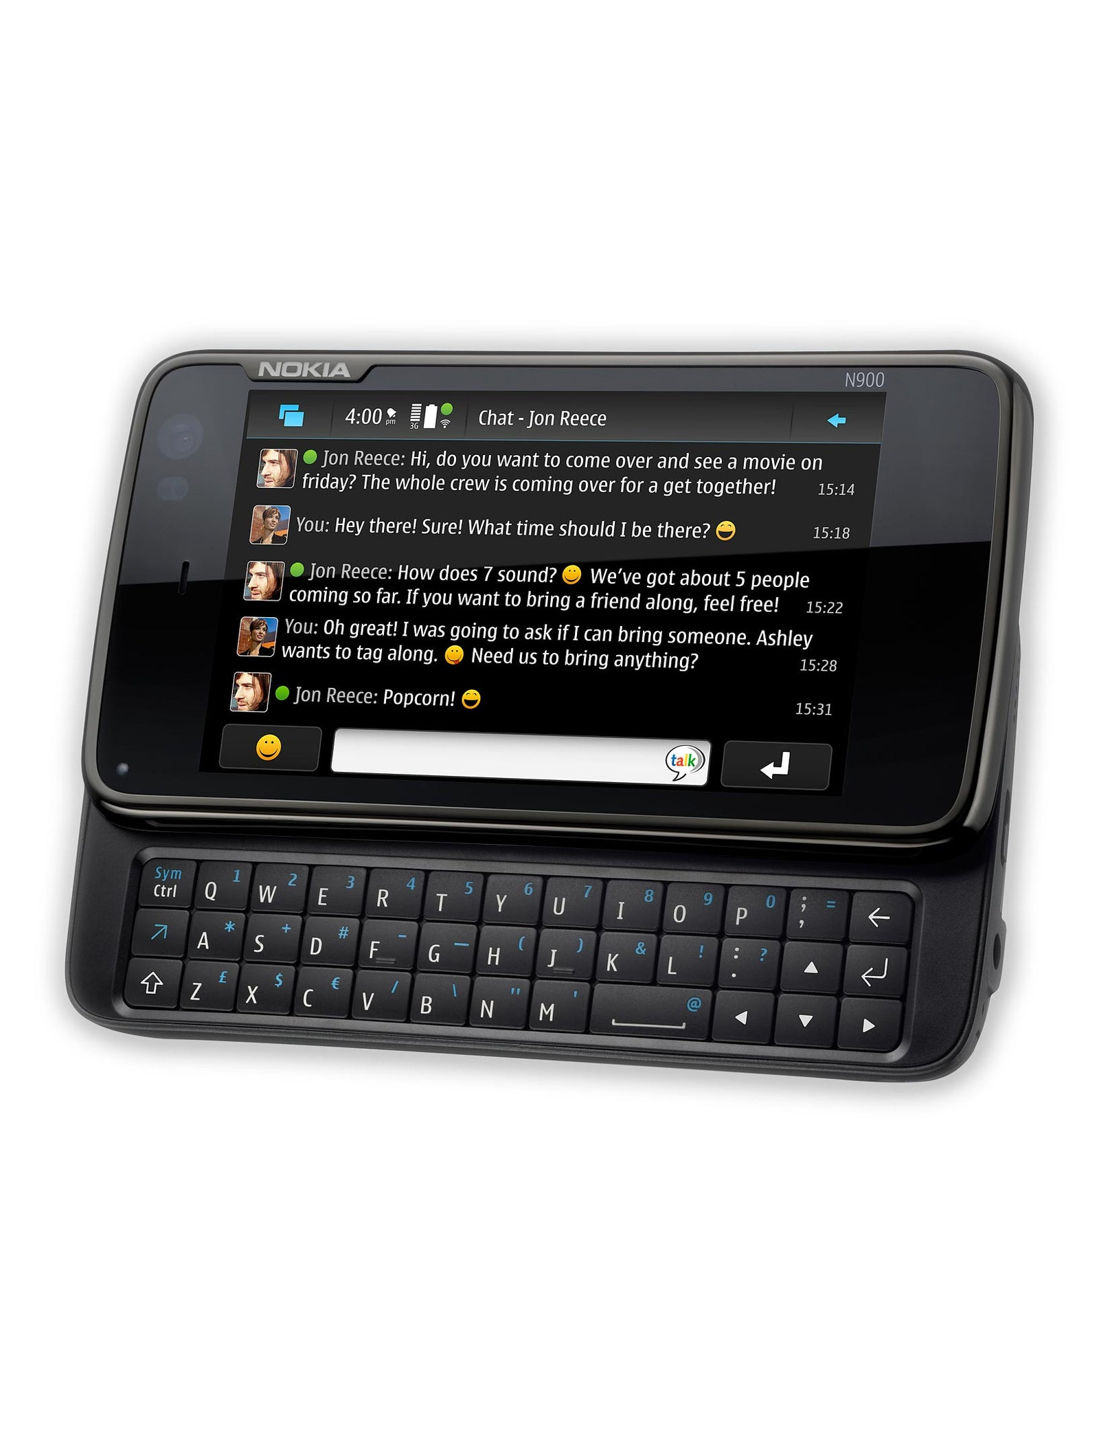
Prehistory
App for Nokia N900
Render music, listen to players, score the performance
676 pages

Slide 16
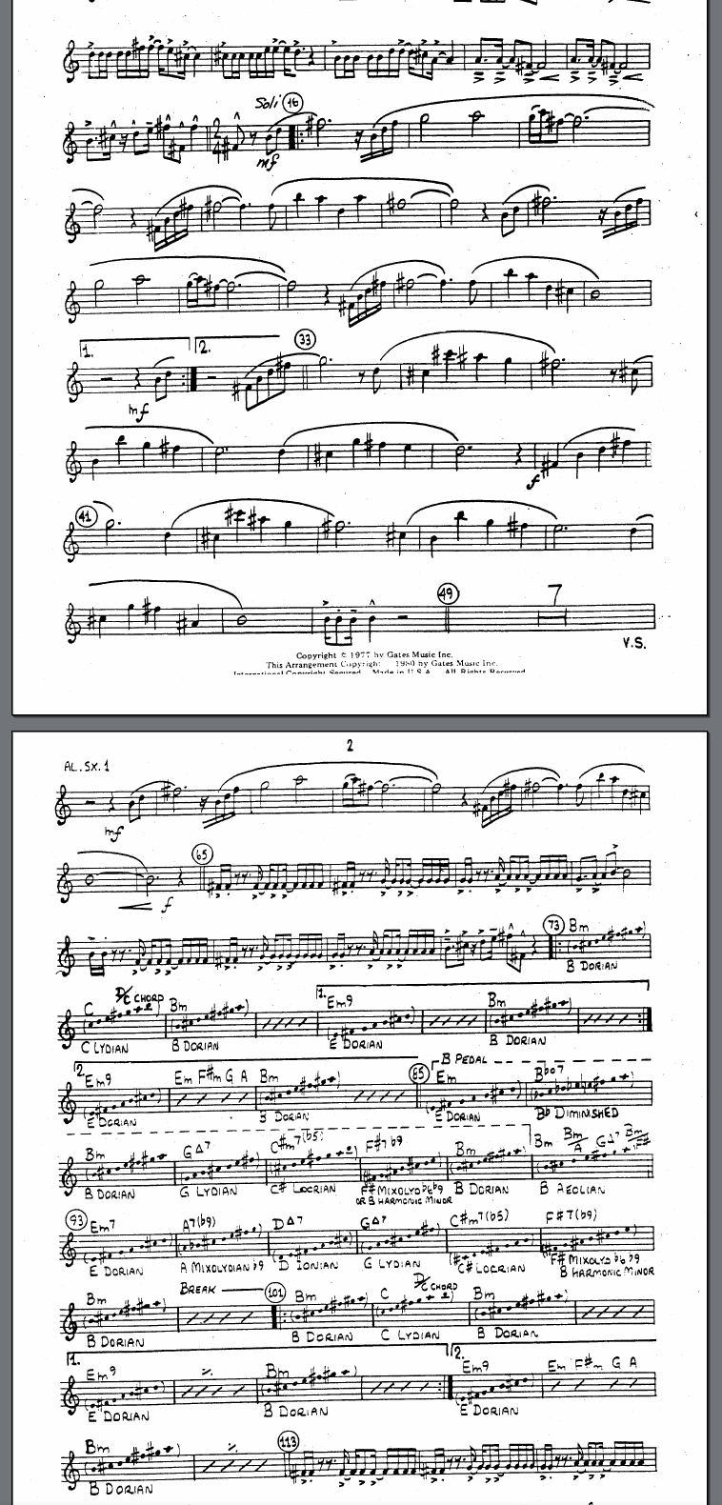
Prehistory II
Convert PDF files to PNG
<img/>
Vertical scrolling

Slide 17
Rehorse Requirements
Rehearse with recordings 🔁
Music Library for Band 🗄
  Archive
  Hand out
  Share annotations
Sheet music reader ♫

Slide 18
Technology
Progressive Web App
Typescript
Vue
pdf.js
NodeJS
The rest of the stack (thank you!)

Slide 19
Progressive Web App
Web app with benefits
Install on Android and iOS without app store
Run full-screen on tablets
Keep screen on
Write once, run anywhere
Local storage: works offline

Slide 20
Server: NodeJS
Typescript on client and server
Storage: json, audio, pdf files
Communication with HTTP and Websocket

Slide 21
Rehearse with recordings
Reason to start an app
Rehearsing with audio is annoying
Whole piece at once
Find the parts you want to study in the recording, play, rewind
Rehorse makes it easier

Slide 22
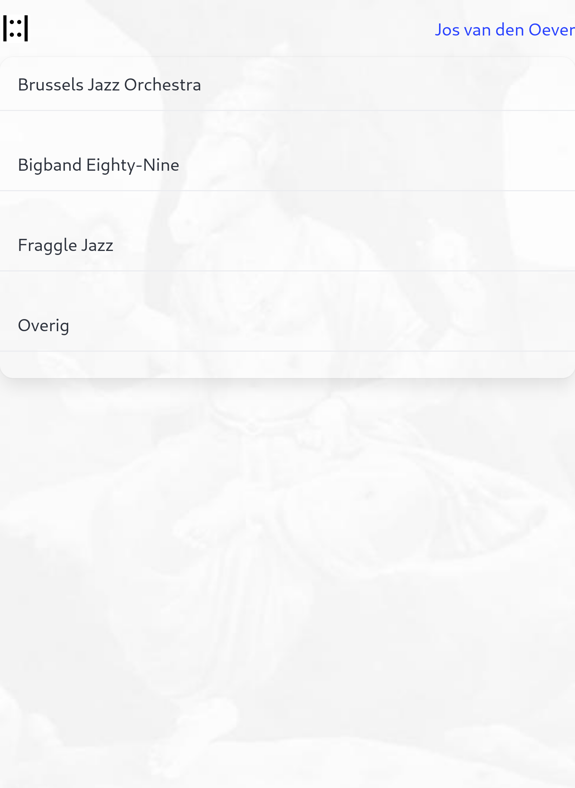
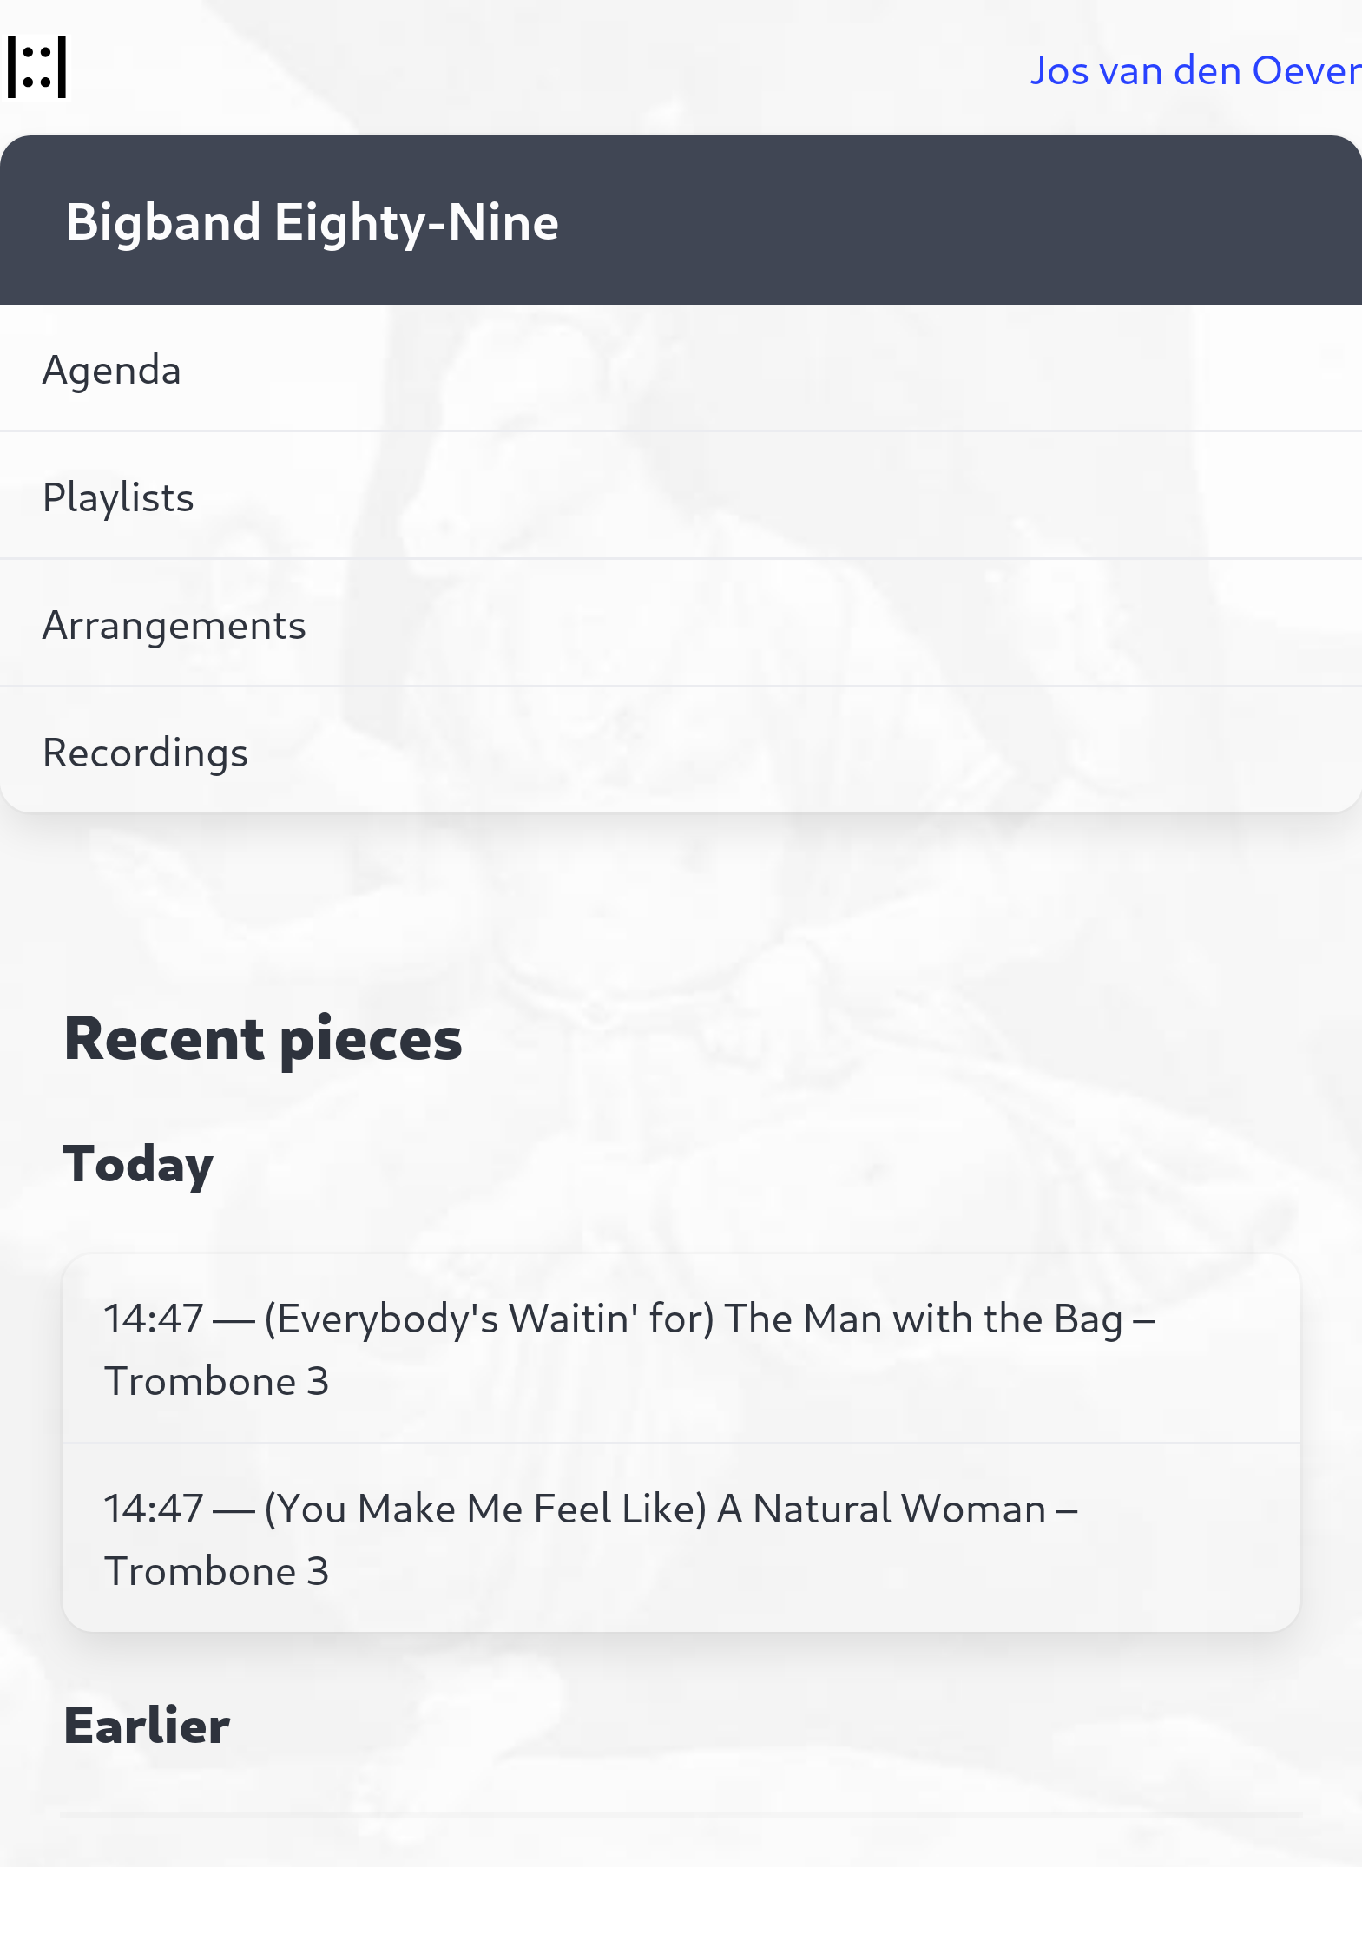

Slide 23
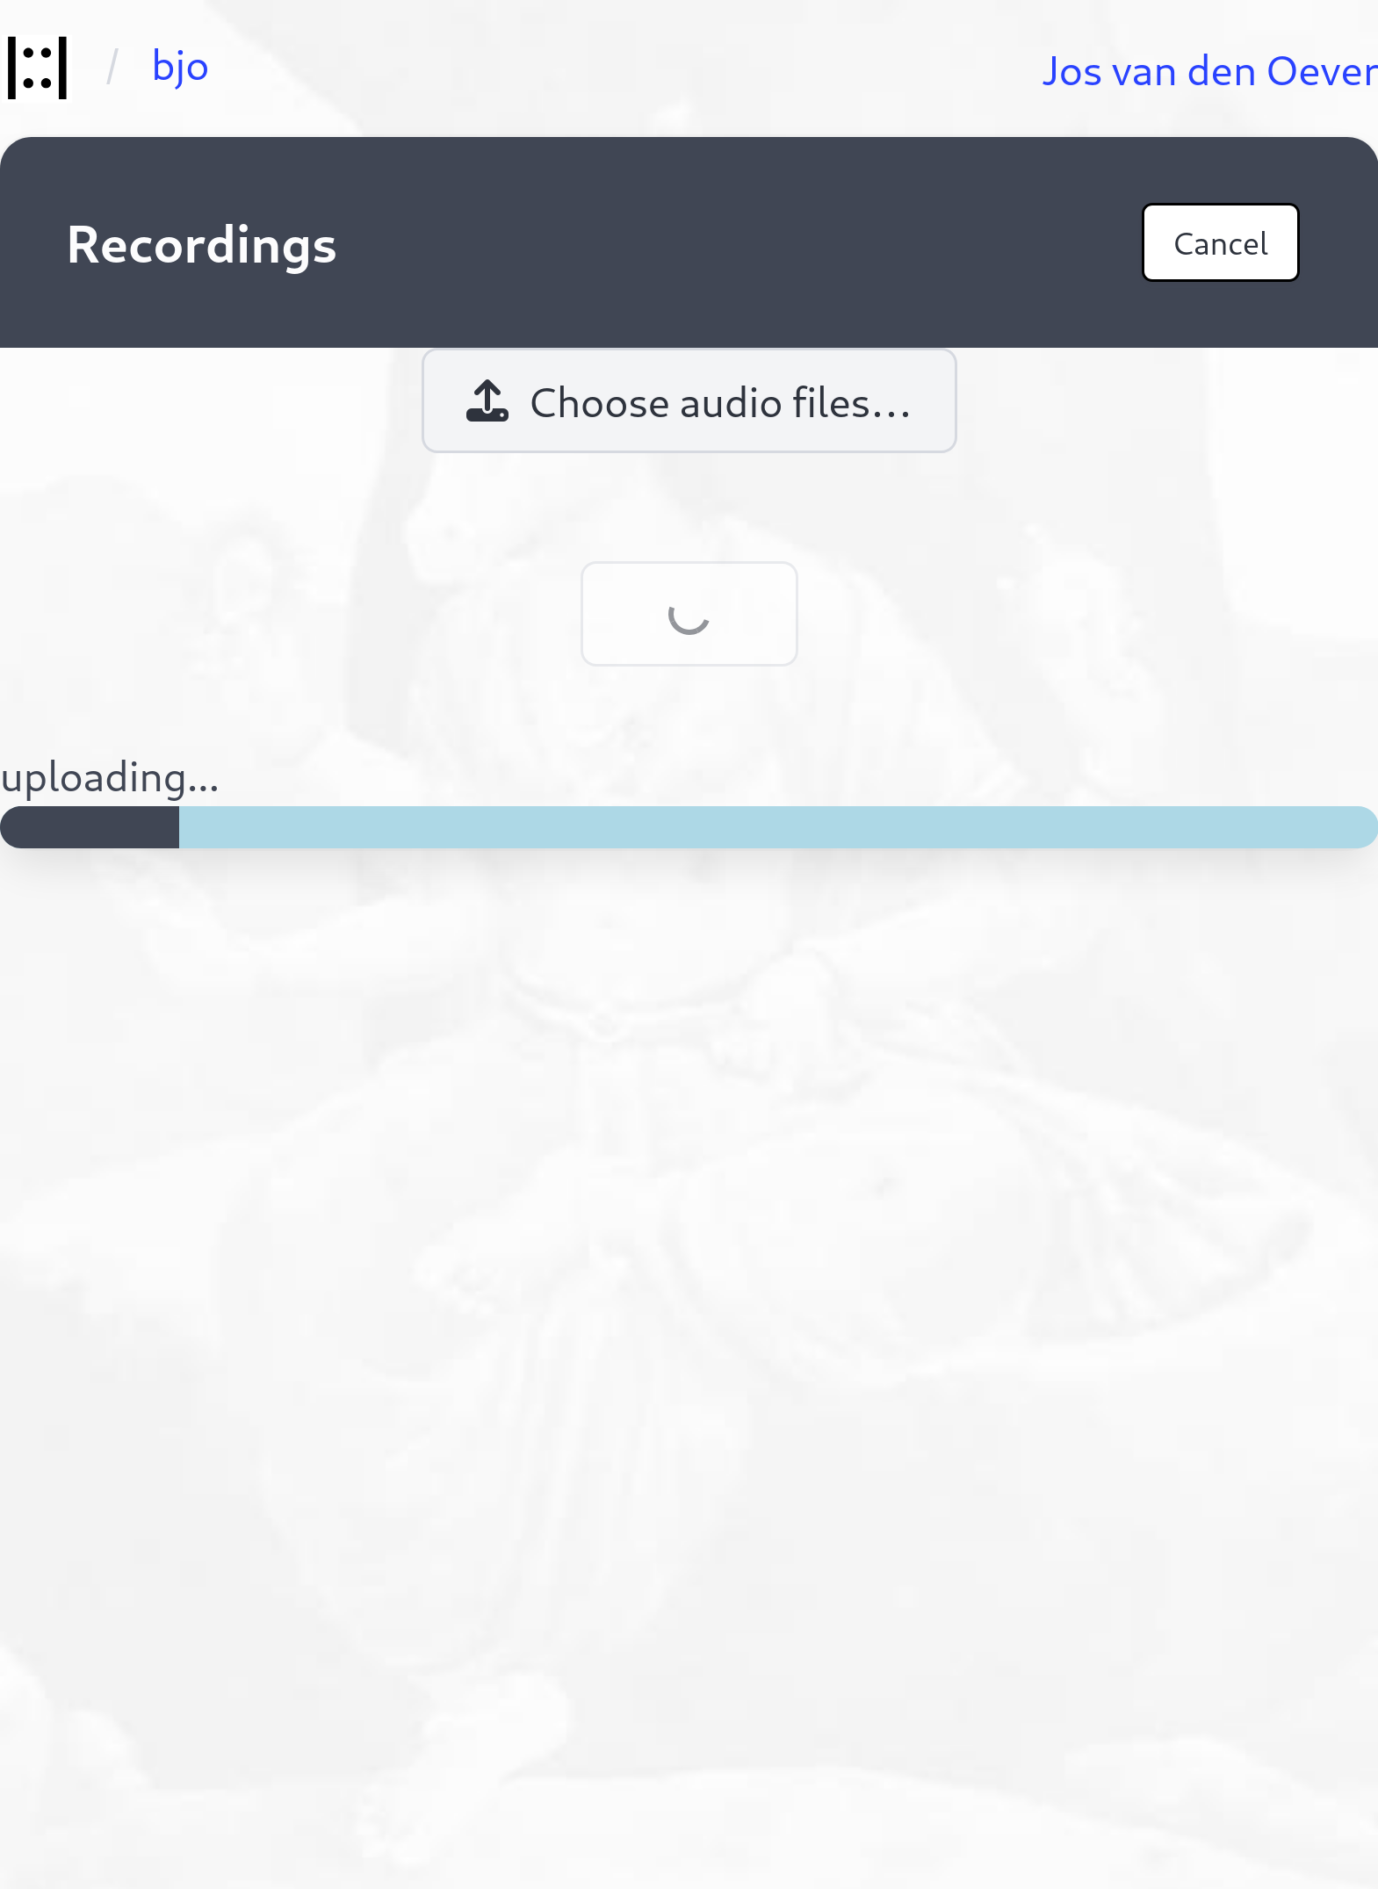
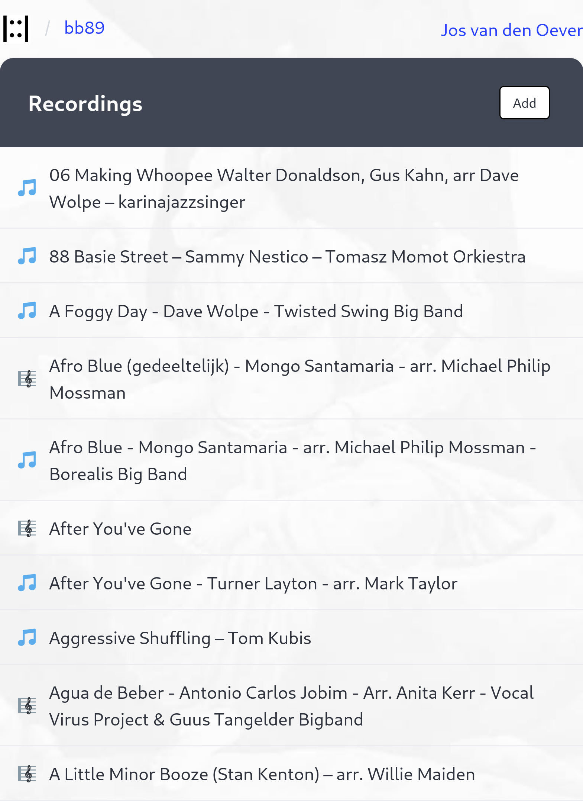

Slide 24
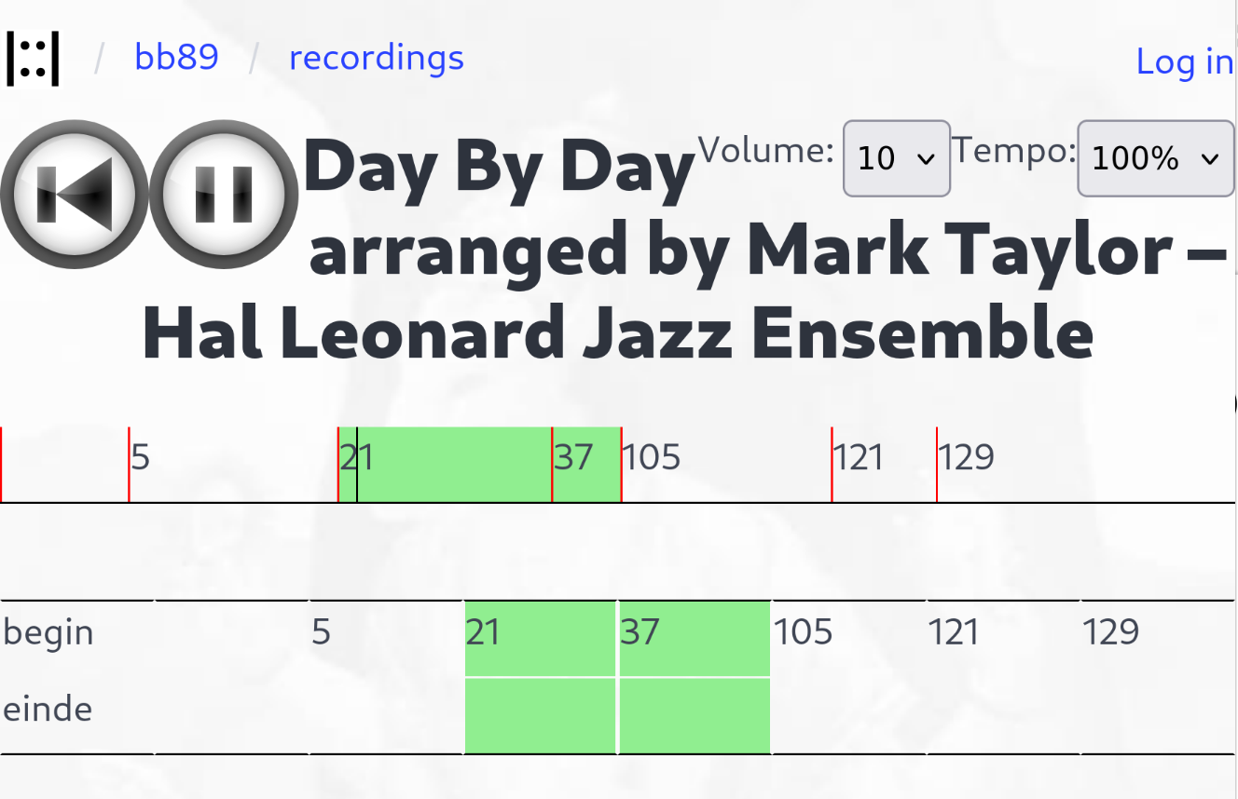
Rehearse with recordings
One person sets the markers corresponding to the sheet music
Everybody can use them

Slide 25
Manage sheet music
Composition has different parts for all the players
Each has to find their part in a collection of pdfs

Slide 26
Manage sheet music
One person uploads the music
Adjust pages
Assigns pages to parts
Watermarks added to each pdf
Everybody download their parts from zip
Or uses the embedded viewer

Slide 27
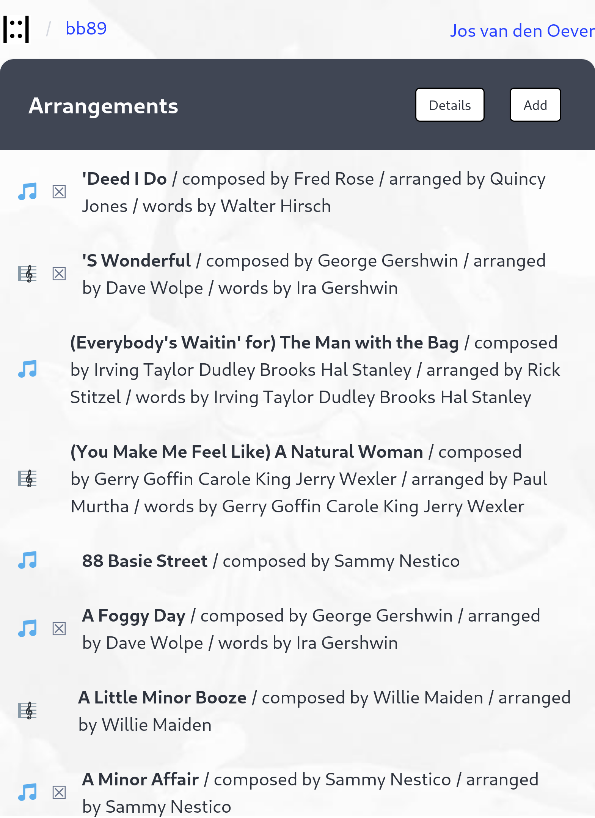
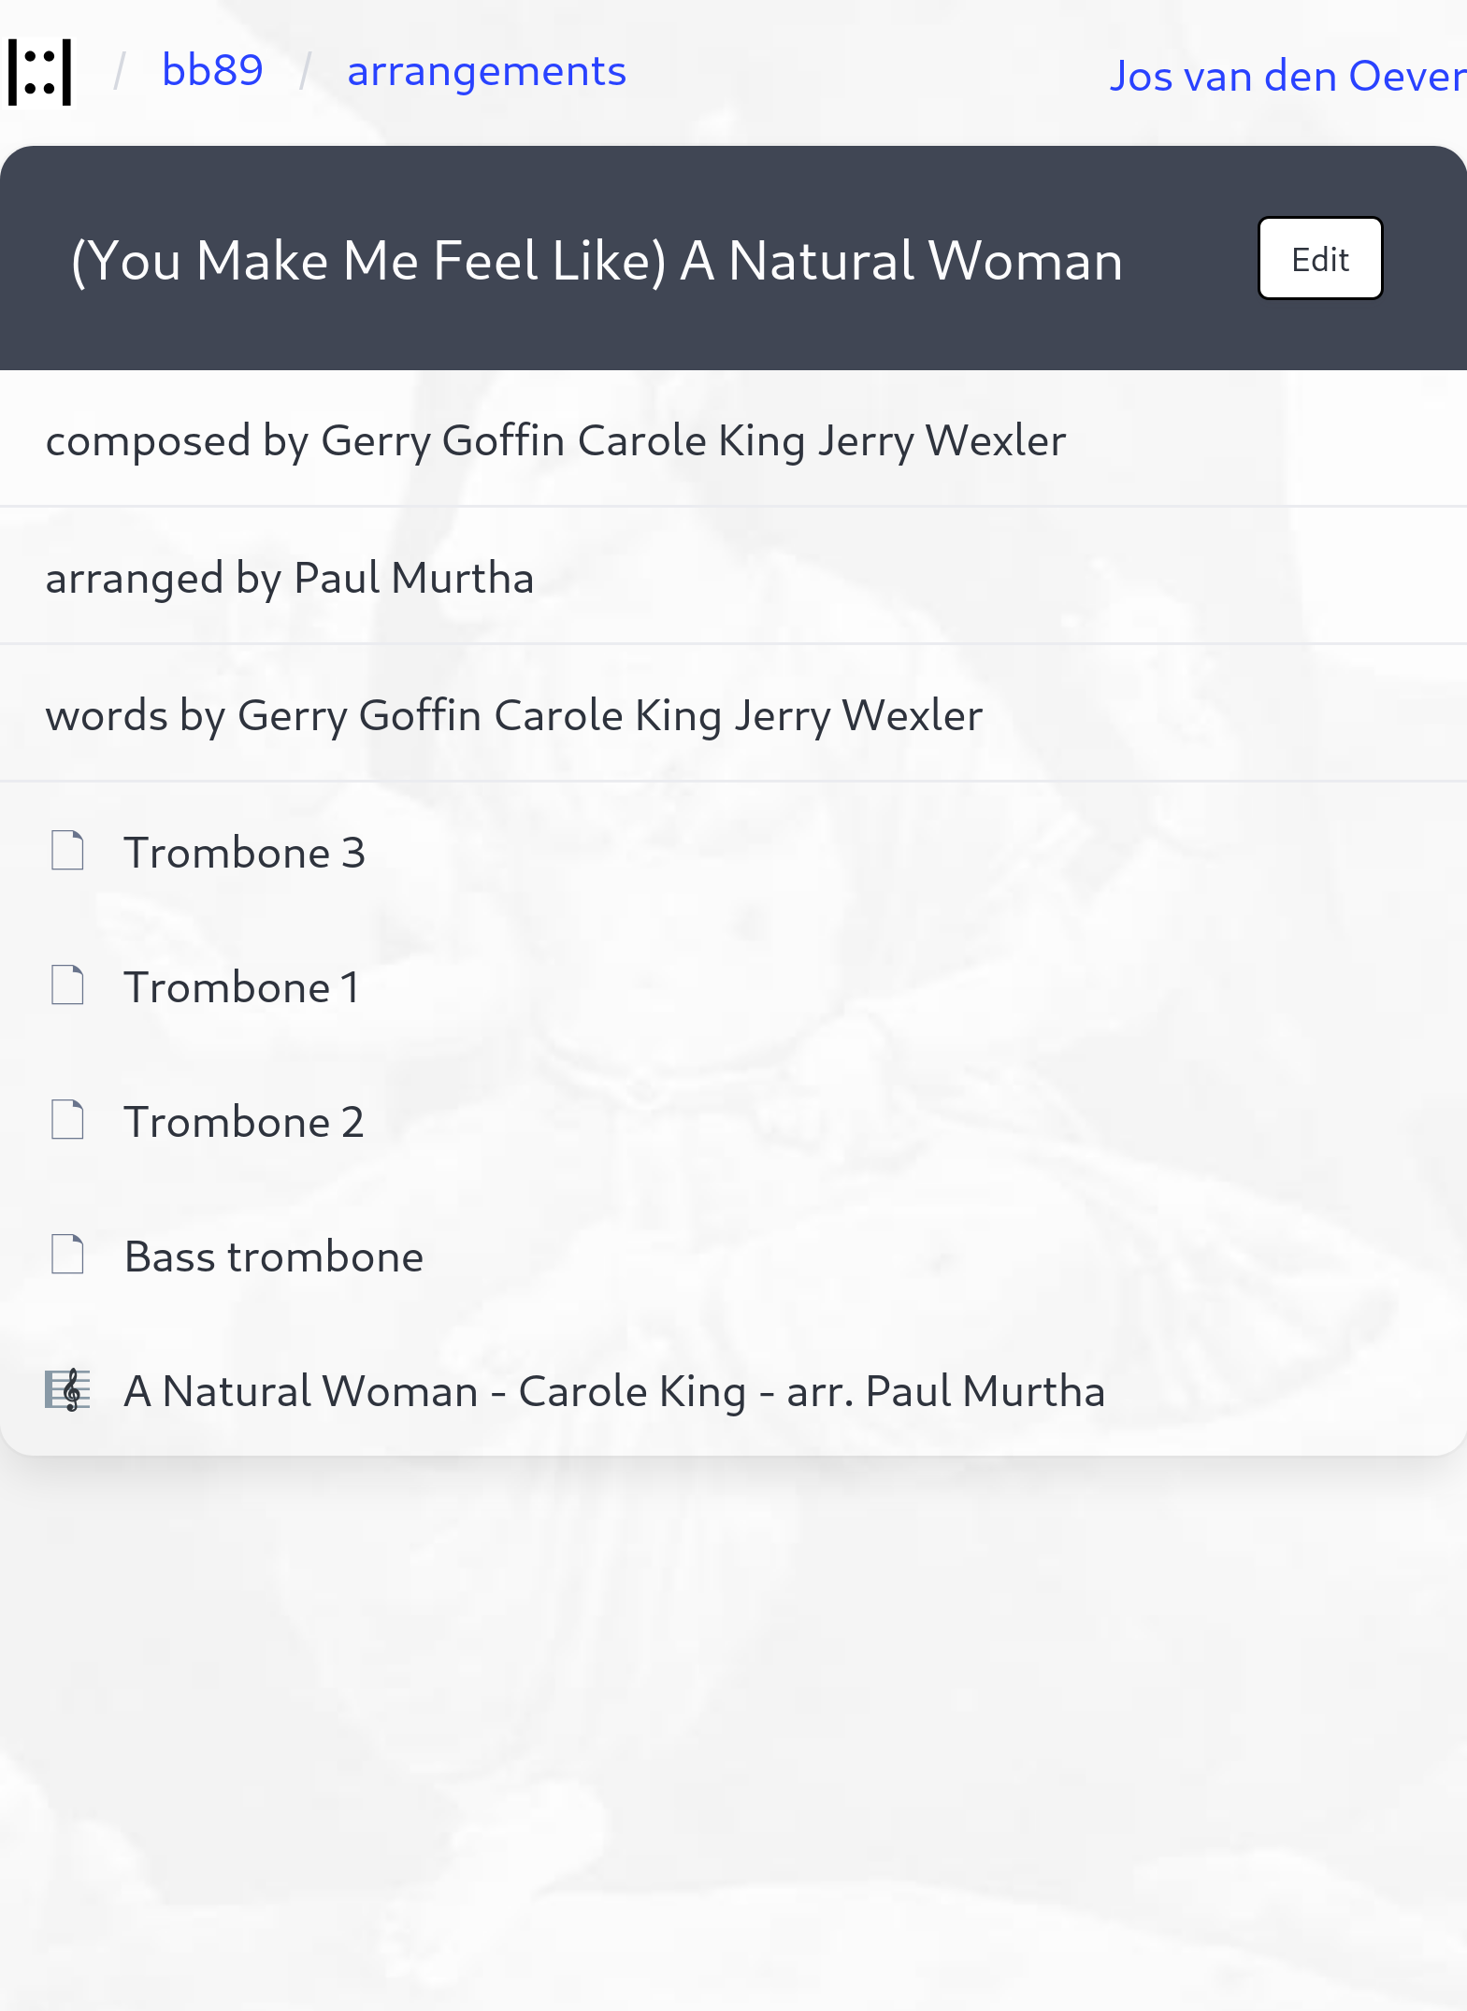

Slide 28
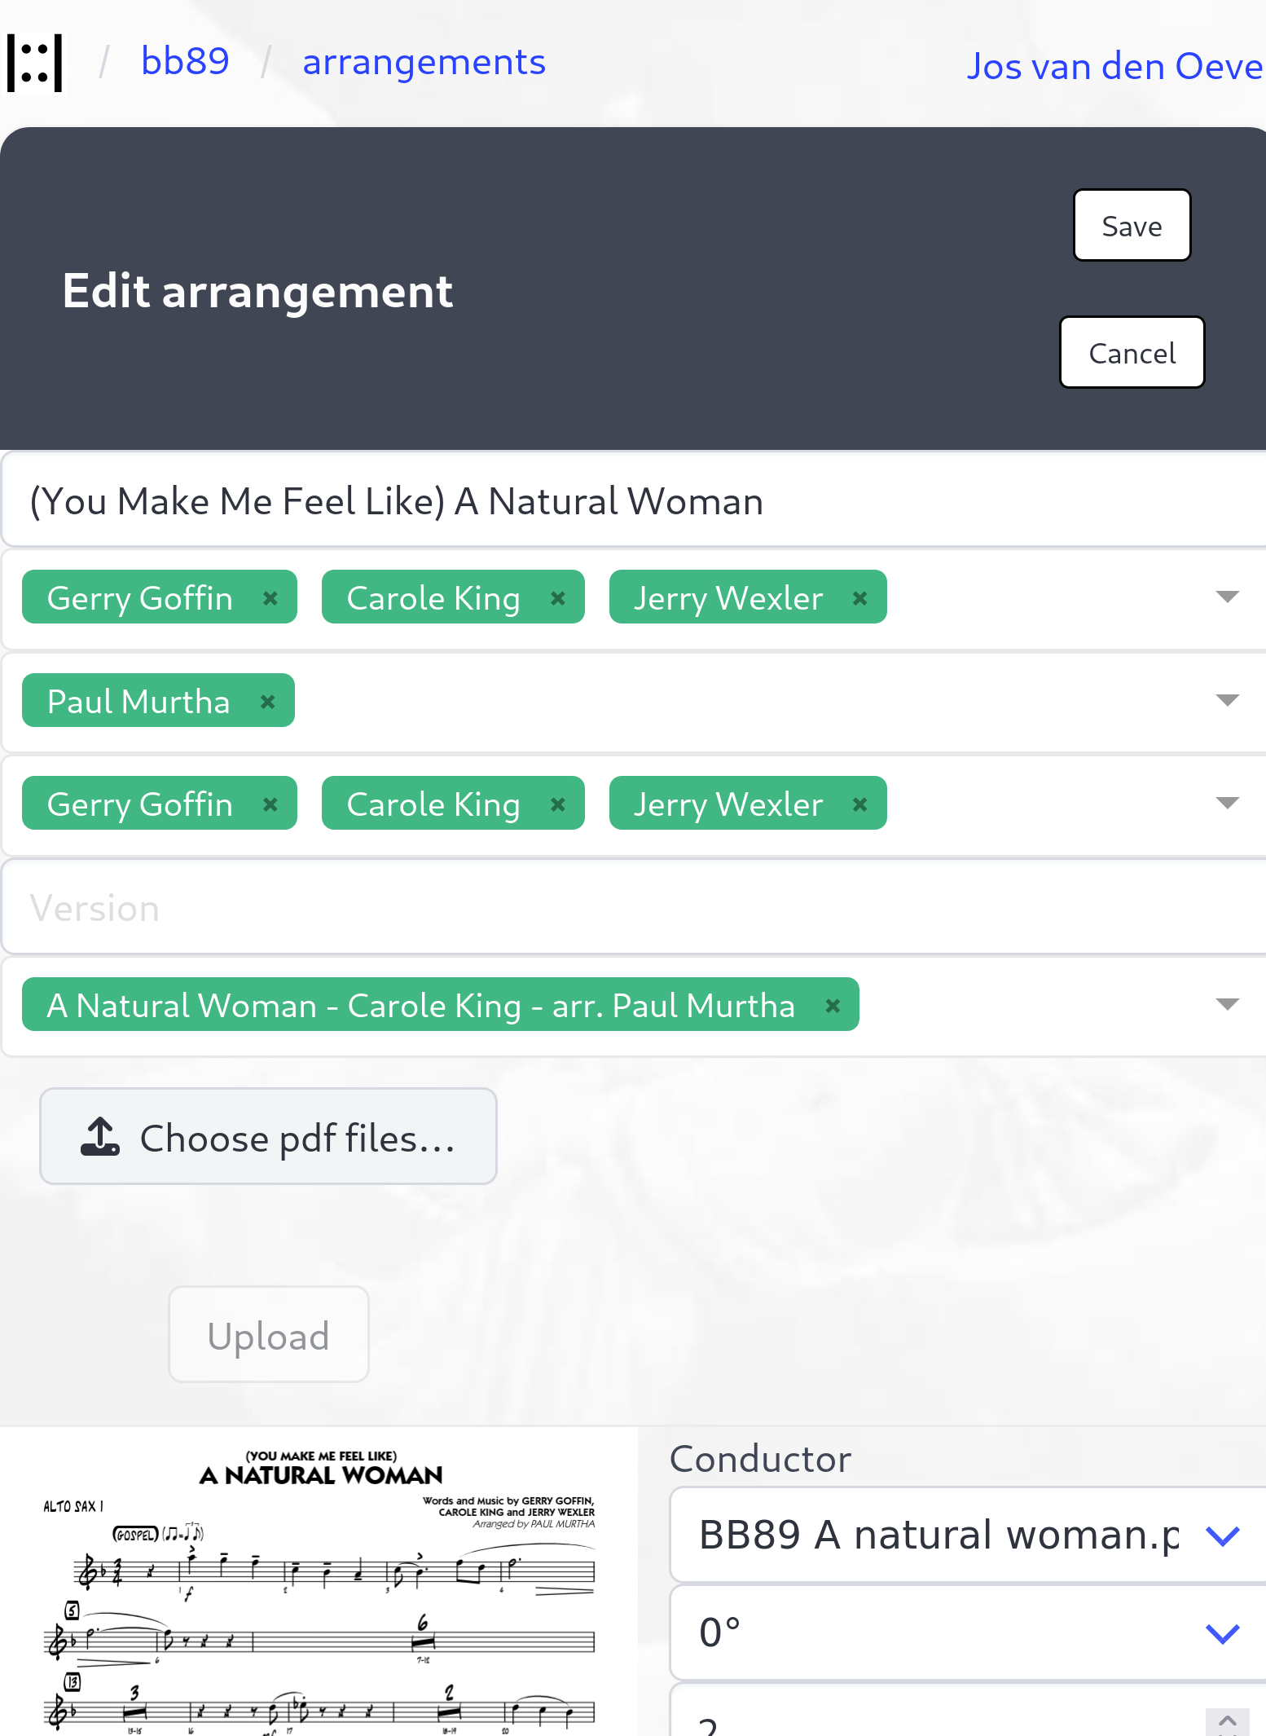
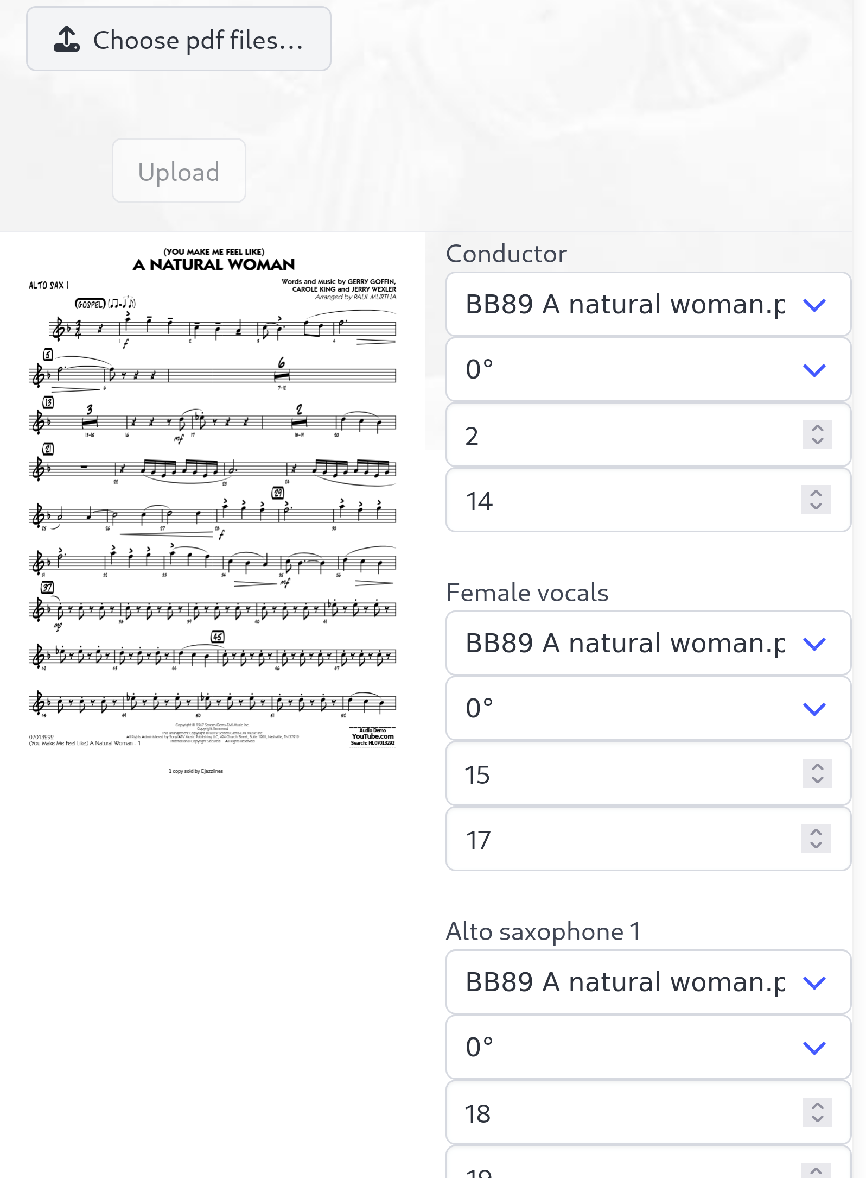

Slide 29
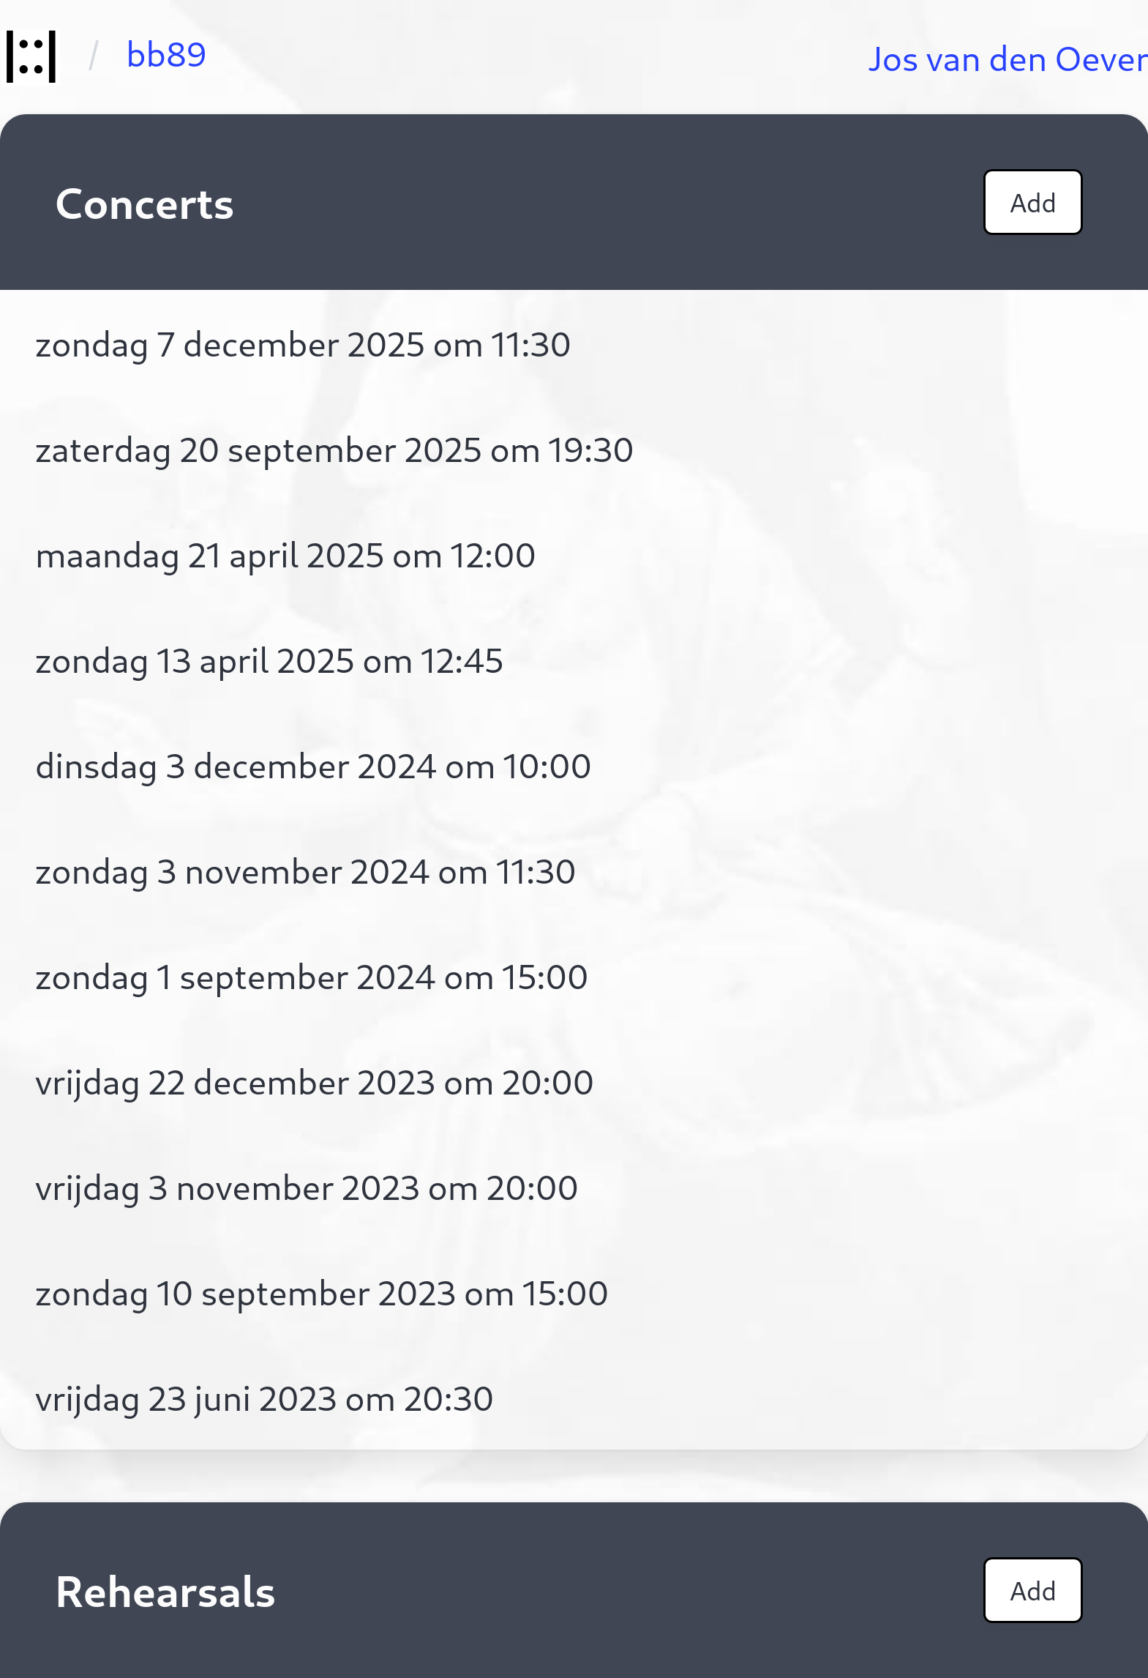
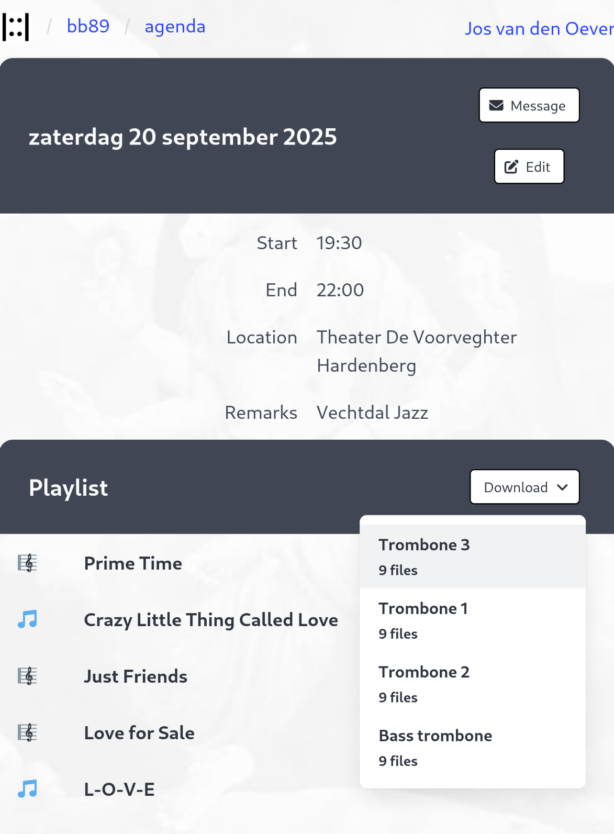

Slide 30
User management

Slide 31
Read and annotate
Render pdf with pdf.js
Annotations on top with svg
Use special music fonts (standardized)
Vertical scrolling
Works offline

Slide 32
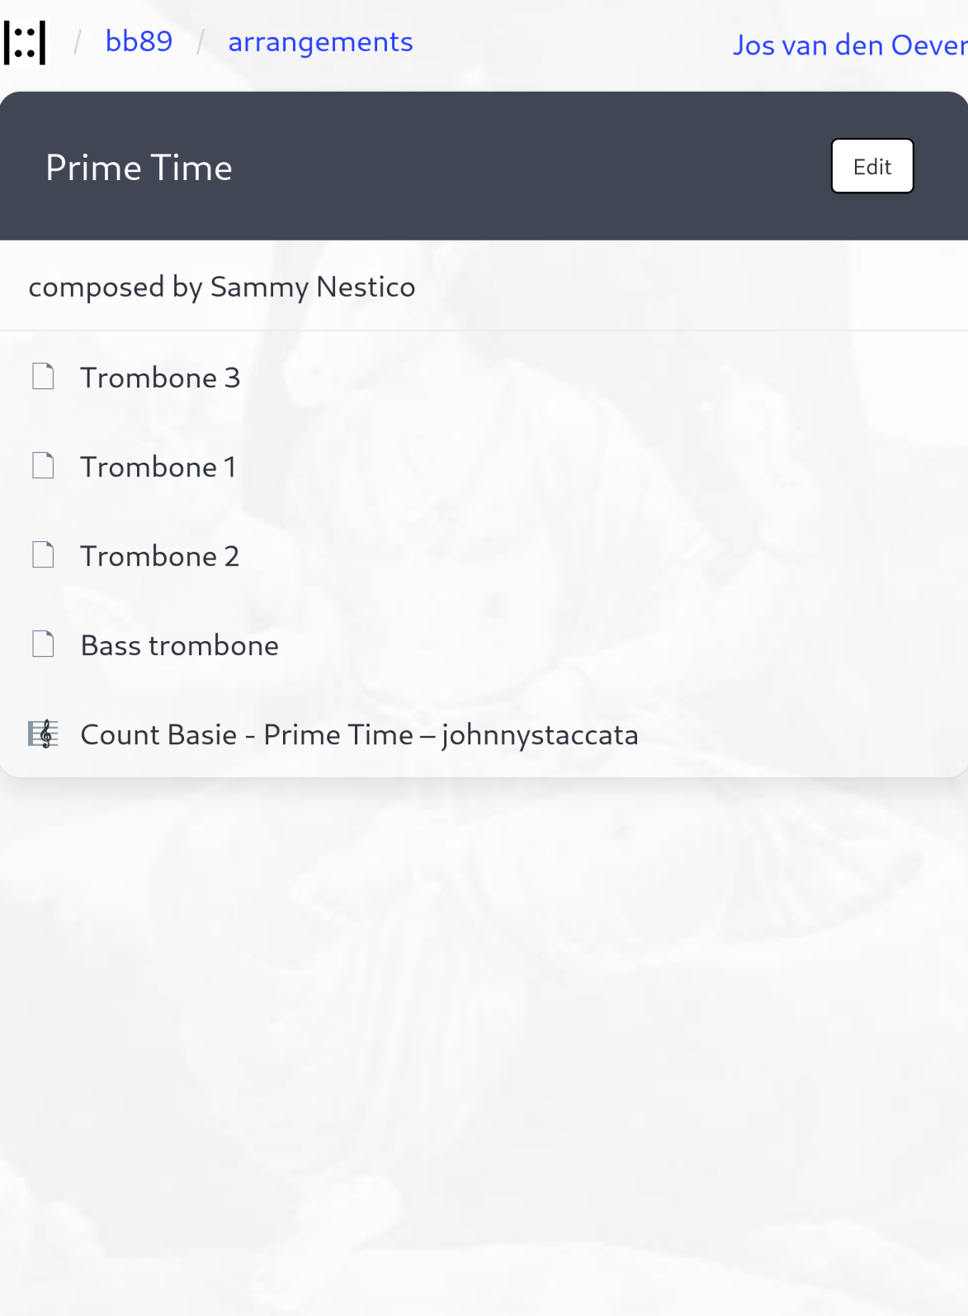
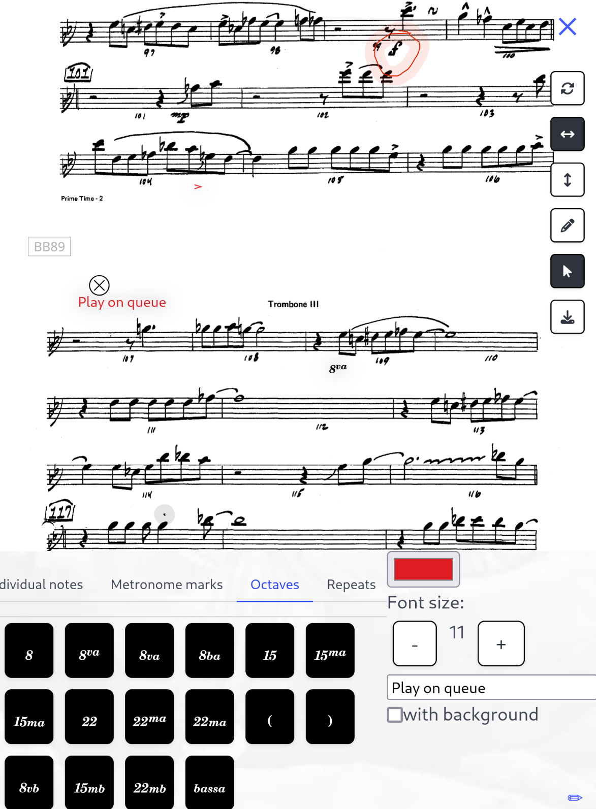

Slide 33
The future
Fix paper cuts
Keep working on newer devices
Documentation, easier installation
Maybe a website
Organic growth

Slide 34
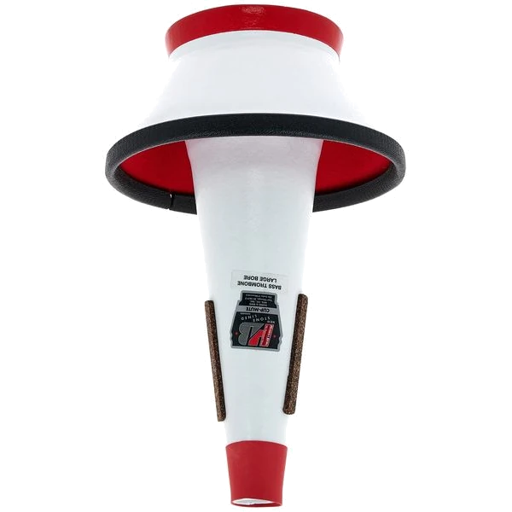
Thank you!

